Slide 1

Department of Information Science & Engineering The National Institute of Engineering, Mysuru Smart Attendance System
Project review by-
1. Rani N S (4NI18IS068)
2. MANJU D R (4NI19ME084)
Guided by -
Miss. Padma M T
Assistant professor of ISE dept

Slide 2
INTRODUCTION
The purpose of the attendance monitoring system using face recognition is to ease the attendance process which consumes lot of time and efforts , it is a convenient and easy way for students and teacher.
The system will capture the images of the students and using face recognition algorithm mark the attendance in the sheet. This way the class-teacher will get their attendance marked without actually spending time in traditional attendance marking.

Slide 3
ABSTRACT
In the era of modern technologies emerging at rapid pace there is no reason why a crucial event in educational sector such as attendance should be done in the old boring traditional way.
Attendance monitoring system will save a lot of time and energy for the both parties students as well as the class teachers. Attendance will be monitored by the face recognition algorithm by recognizing only the face of the students from the rest of the objects and then marking them as present.
The system will be pre feed with the images of all the students and with the help of this pre feed data the algorithm will detect them who are present and match the features with the already saved images of them present in the database.

Slide 4
REQUIREMENT
Software Requirements :
Operating System : Windows OS.
Platform: Android Studio.
Programming Language : PHYTON.
Hardware Requirements :
Processor: INTEL Pentium 4 Processor Core.
Hard Disk: 40 GB (min).
RAM: 256 MB or higher.

Slide 5
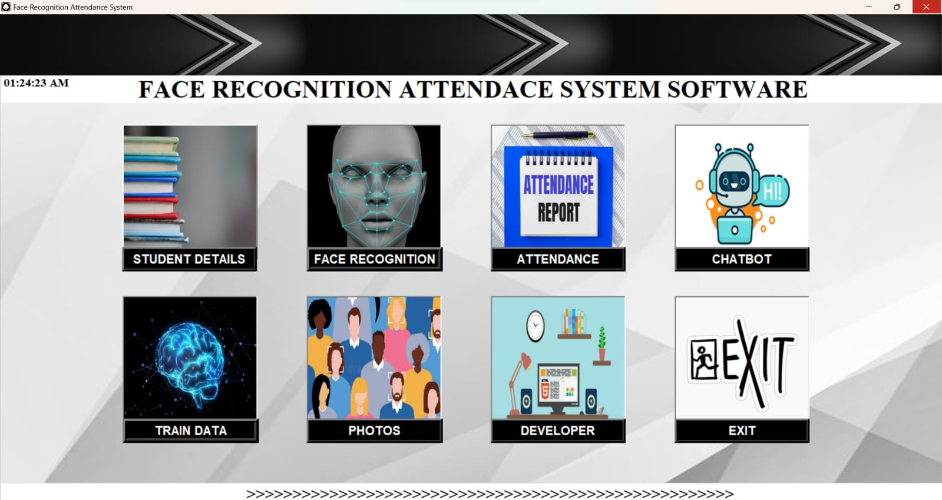
USER INTERFACE

Slide 6
FLOWCHART
Add students information and face in database
Database is trained in backend
Open the camera for recognition
Face recognition done
Attendance with date and time saved in database

Slide 7
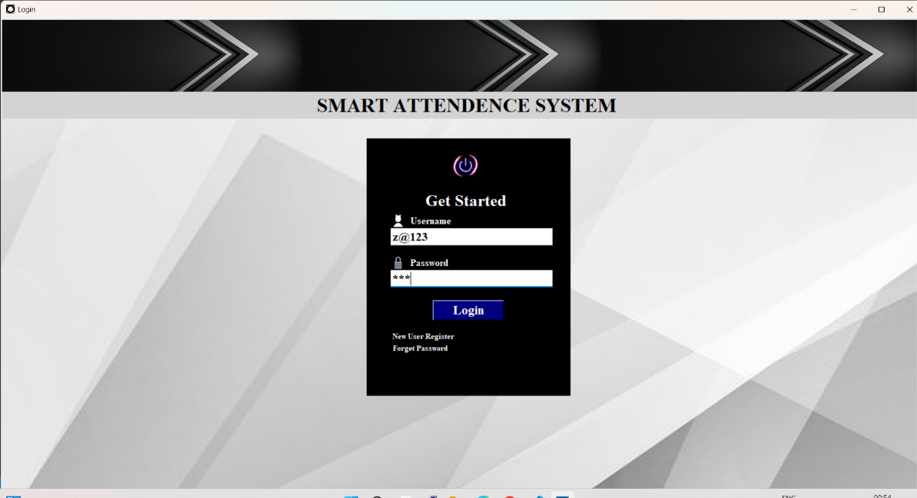
Login system
Login system used to login new user register .

Slide 8
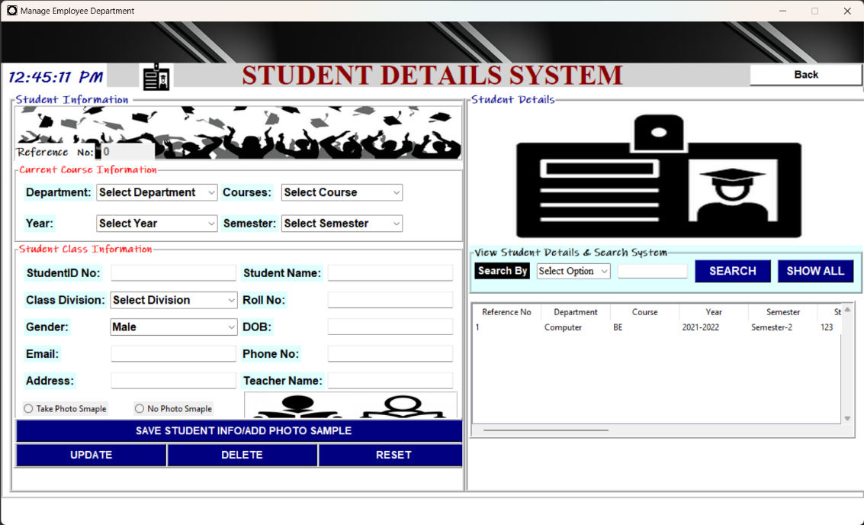
Registering a new student
After successfully registered a new student and inserted his entry into the students table, the student has to register his face by taking 100 pictures of his face at various angles in a well lit room which is then inserted into the studentImages table which contains the images of all student faces. To initialize the webcam, perform face detection and capture the detected face

Slide 9
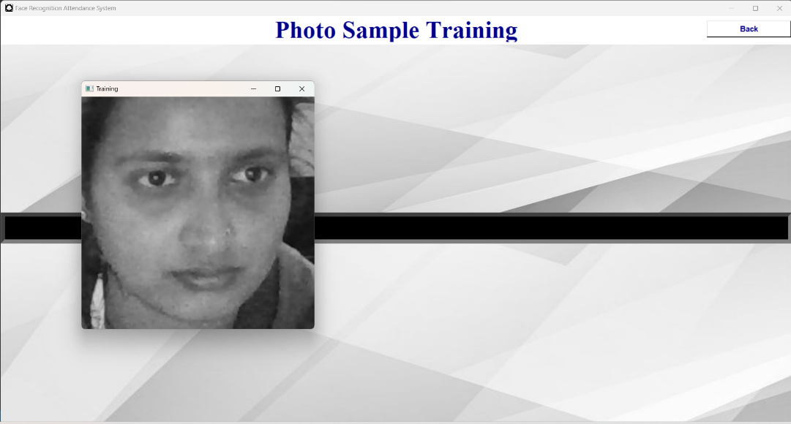
Train data
First, we need to train the algorithm using a vast number of images to create ‘faceprints’ of people by mapping the geometry of certain facial features.

Slide 10
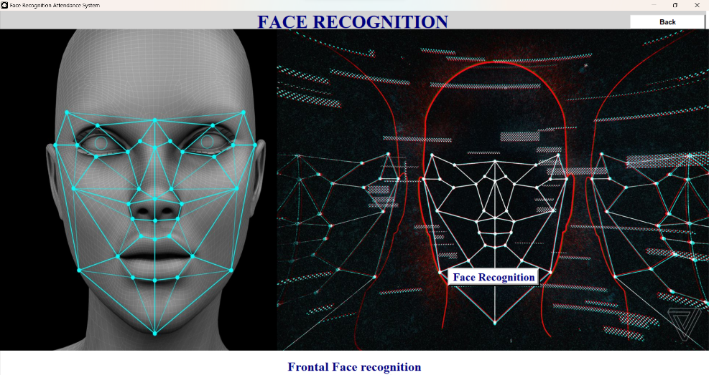
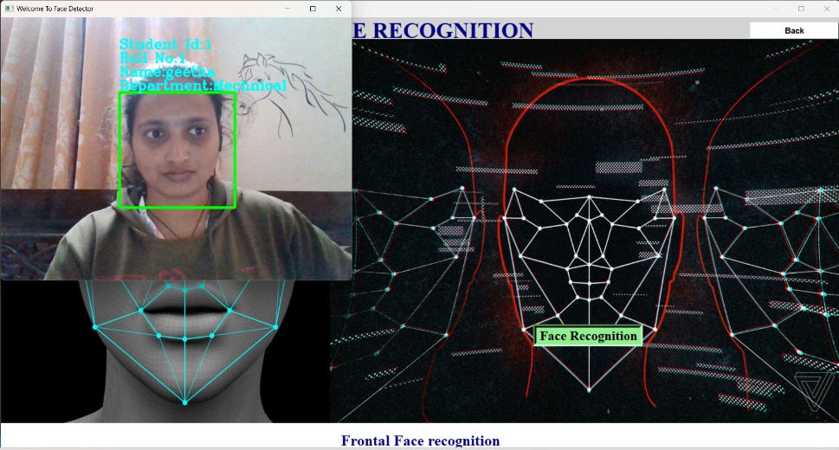
Recognition face
The name, department, student ID, and roll number of captured student image is predicted and displayed above the detected face.

Slide 11
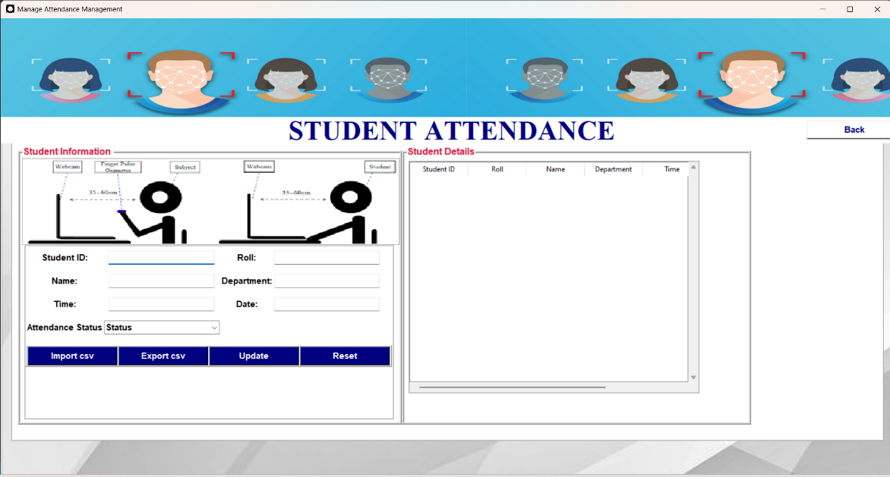
Updating attendence
Once a student joins a class session, a new thread is created to handle the predicted register number results from each student, thereby marking his attendance. To handle students.

Slide 12
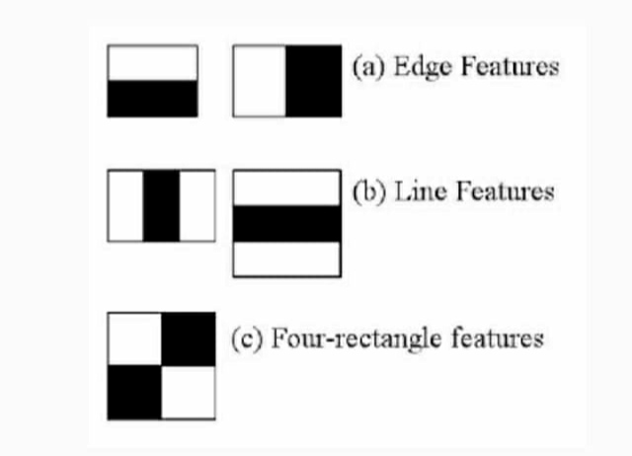
HAAR CASCADE ALGORITHM
It is an object detection algorithm used to identify faces in an image or a real time.
The algorithm is given a lot of positive images consisting of faces, and a lot of negative images not consisting of any face to train on them.

Slide 13
LBPH ALGORITHM
The Local Binary Pattern Histogram(LBPH) algorithm is a simple solution on face recognition problem, which can recognize both front face and side face.
Local Binary Pattern (LBP) is a simple yet very efficient texture operator which labels the pixels of an image by thresholding the neighbourhood of each pixel and considers the result as a binary number.

Slide 14
DETECTION AND RECOGNITION
Face Detection: It has the objective of finding the faces (location and size) in an image and probably extract them to be used by the face recognition algorithm.
Face Recognition: with the facial images already extracted, cropped, resized and usually converted to grayscale, the face recognition algorithm is responsible for finding characteristics which best describe the image.

Slide 15
VERIFIACATION
Verification or authentication of a facial image: it basically compares the input facial image with the facial image related to the user which is requiring the authentication. It is basically a 1x1 comparison.
Identification or facial recognition: it basically compares the input facial image with all facial images from a dataset with the aim to find the user that matches that face. It is basically a 1xN comparison.

Slide 16
PARAMETERS OF LBPH
Radius: the radius is used to build the circular local binary pattern and represents the radius around the central pixel. It is usually set to 1.
Neighbors: the number of sample points to build the circular local binary pattern ,the more sample points we include, the higher the computational cost. It is usually set to 8.
Grid X: the number of cells in the horizontal direction. The more cells, the finer the grid, the higher the dimensionality of the resulting feature vector. It is usually set to 8.
Grid Y: the number of cells in the vertical direction. The more cells, the finer the grid, the higher the dimensionality of the resulting feature vector. It is usually set to 8.

Slide 17
TRAINING ALORITHM
Training the Algorithm: First, we need to train the algorithm. To do so, we need to use a dataset with the facial images of the people we want to recognize. We need to also set an ID (it may be a number or the name of the person) for each image, so the algorithm will use this information to recognize an input image and give you an output. Images of the same person must have the same ID.

Slide 18
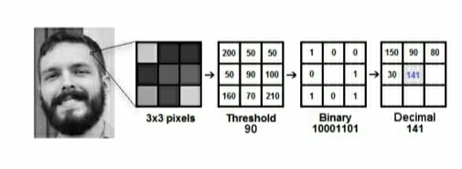
APPLYING LBP ALGORITHM
The first computational step of the LBPH is to create an intermediate image that describes the original image in a better way, by highlighting the facial characteristics. To do so, the algorithm uses a concept of a sliding window, based on the parameters radius and neighbors.

Slide 19
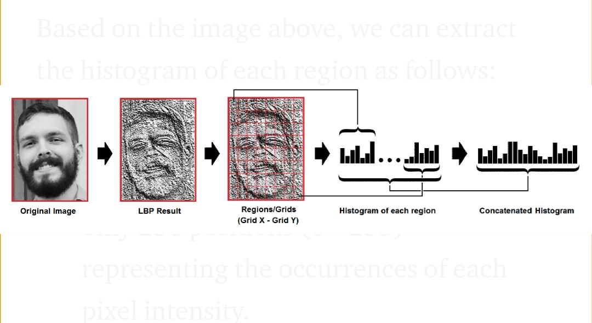
EXTRACTING HISTOGRSM
Now, using the image generated in the last step, we can use the grid X and grid Y parameters to divide the image into multiple grids, as can be seen in the following image:

Slide 20
PERFORMING THE FACE RECOGNITION
In this step, the algorithm is already trained. Each histogram created is used to represent each image from the training dataset. So, given an input image, we perform the steps again for new image and creates a histogram which represents the image.

Slide 21
ADVANTAGES
It is trouble-free to use.
It is a relatively fast approach to enter attendance
Is highly reliable, approximate result from user
Best user Interface

Slide 22
REFERANCES
G. Satyanarayanareddy, rallabandisrinivasu, srikanth reddyrikkula, vuda sreenivasarao,” management information system to help managers for providing decision making in an organization”, international journal of reviews in computing.
G.Satyanarayana reddy,rallabandi srinivasu,srikanth reddy rikkula,vuda sreenivasa rao,” management information system to help managers for providing decision making in an organization”, international journal of reviews in computing.
Other websites;-
Http://www.Wordpress.Org/
Http://www.Academia.Edu/
Http://www.Stackoverflow.Com/
Http://www.Iproject.Com

Slide 23
CONCLUSION
The Attendance Management System is developed using Machine Learning meets the objectives of the system which it has been developed. The system has reached a steady state where all bugs have been eliminated. The system is operated at a high level of efficiency. The system solves the problem. It was intended to solve as requirement specification.

Slide 24
THANK YOU ☺

